Slide 1

Diabetes Health
Risk Prediction
Danish Mohammad, Joshua Perez, Ria Datla

Slide 2

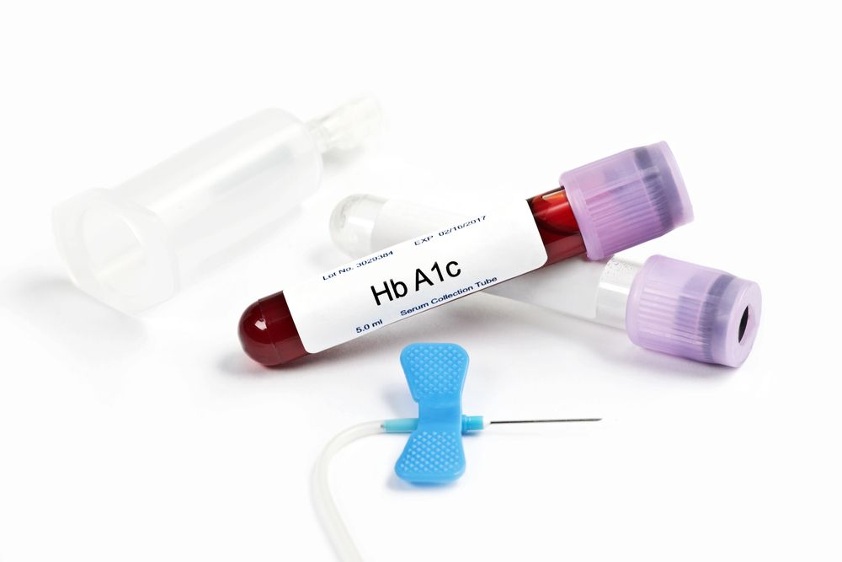
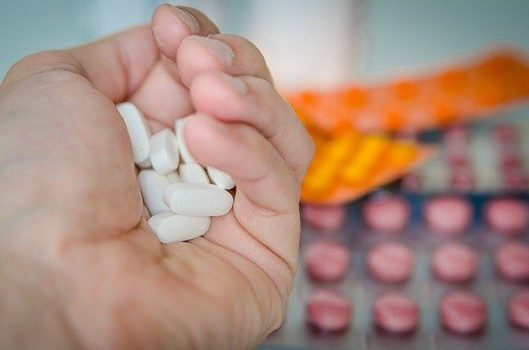
+
Agenda
+
Executive Summary
Data Collection, Cleanup and Exploration
Machine Learning Model Selection, Training and Evaluation
Model Optimization and Performance
Approach and Future Work
Results and Conclusion
Appendix
+
+

Slide 3
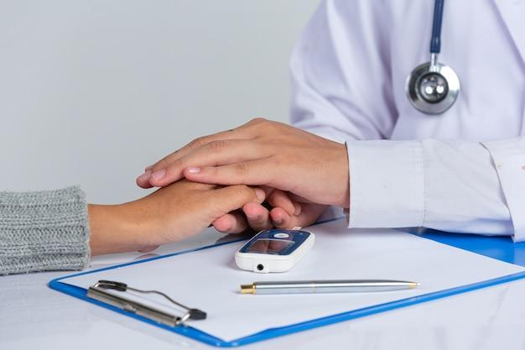
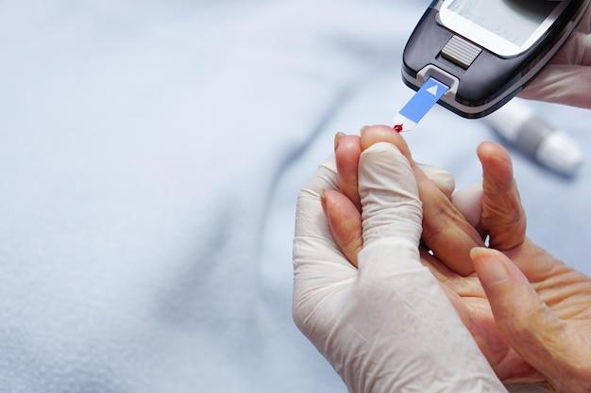
Executive Summary
Objective and Significance Screen pre-diabetes/diabetes outcomes using various health indicators and understand those diabetes risk factors to enable early detection
Goals
Develop a predictive model to screen patients and predict their risk of pre-diabetes/diabetes

Slide 4
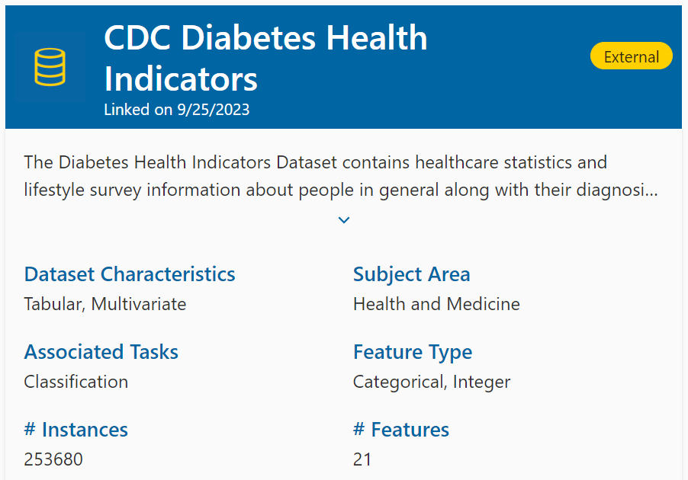
+
Data Collection and Source
Dataset Source:
CDC Diabetes Health Indicators Dataset
(The underlying uncleaned data comes from the CDC's BRFSS 2015)
Description:
Lifestyle factors that relate to diabetes.
(View appendix for a breakdown of all factors)
+
+
+
Notes:
Reason for Choice: Relevance to public health, published by the CDC, comprehensiveness of indicators, no missing values, 200k+ records/instances of data to analyze

Slide 5
Features Selected
High BP
High Cholesterol
Cholesterol Check
BMI
Smoker
Stroke
Heart Disease or Attack
Heavy Alcohol Consumption.
Physical Activity
Fruits
Veggies
General Health
Metal Health
Physical Health
Difficulty Walking
Sex
Age
Education
Income
Healthcare
Notes:
Features dropped:
Income, Healthcare
[insert notes about each one]

Slide 6
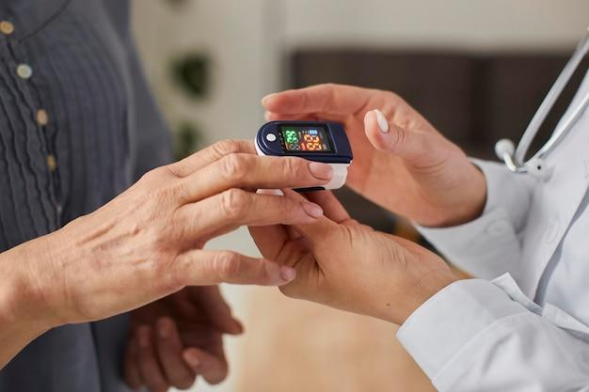
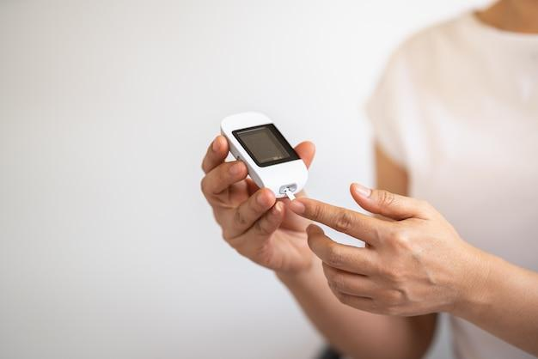
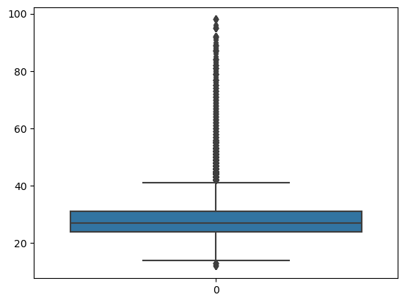
Data Cleanup
+
+
Imbalance
Identified the imbalance of positive and negative cases which lead to our later decision to resample the data
+
BMI Outliers
Tested the model with the full dataset and when outliers were removed for BMI metrics to improve the performance of our model
+

Slide 7
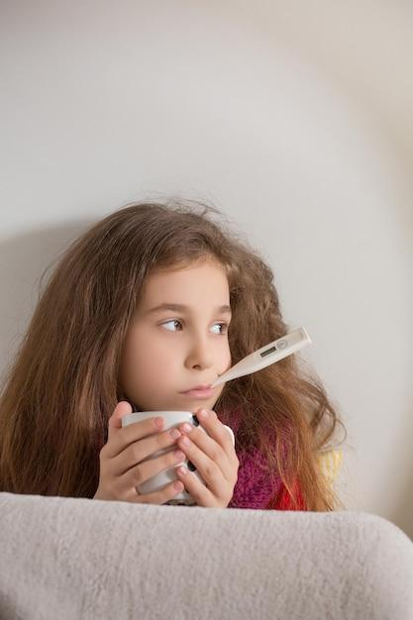
Models Selected
+
+
+
Logistics Regression
Estimates the probability of an event occurring
Decision Tree
Uses a tree-like structure to make predictions by repeatedly asking questions based on data features
Random Forest
Uses a collection of decision trees to make predictions
+

Slide 8
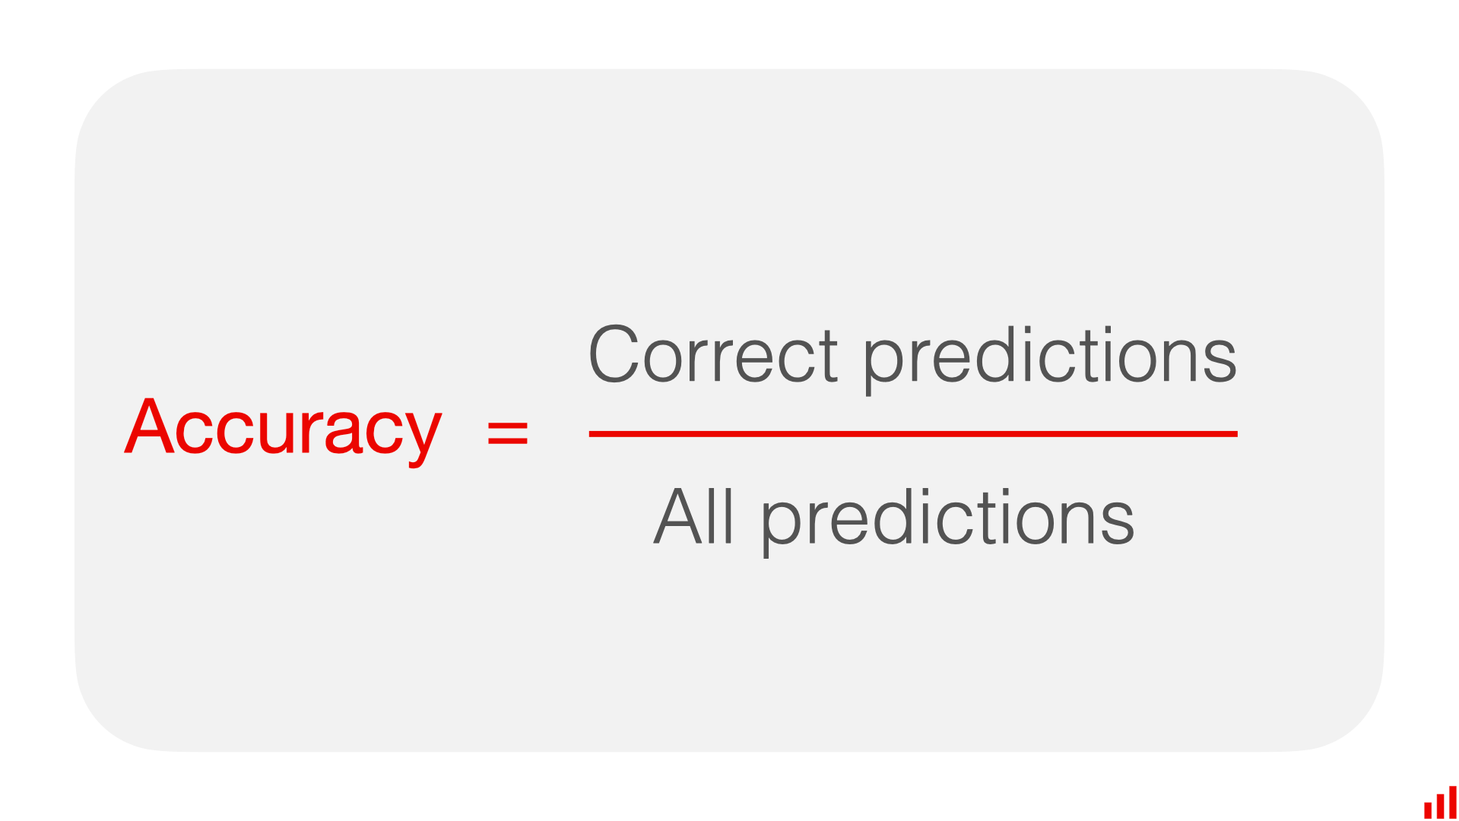
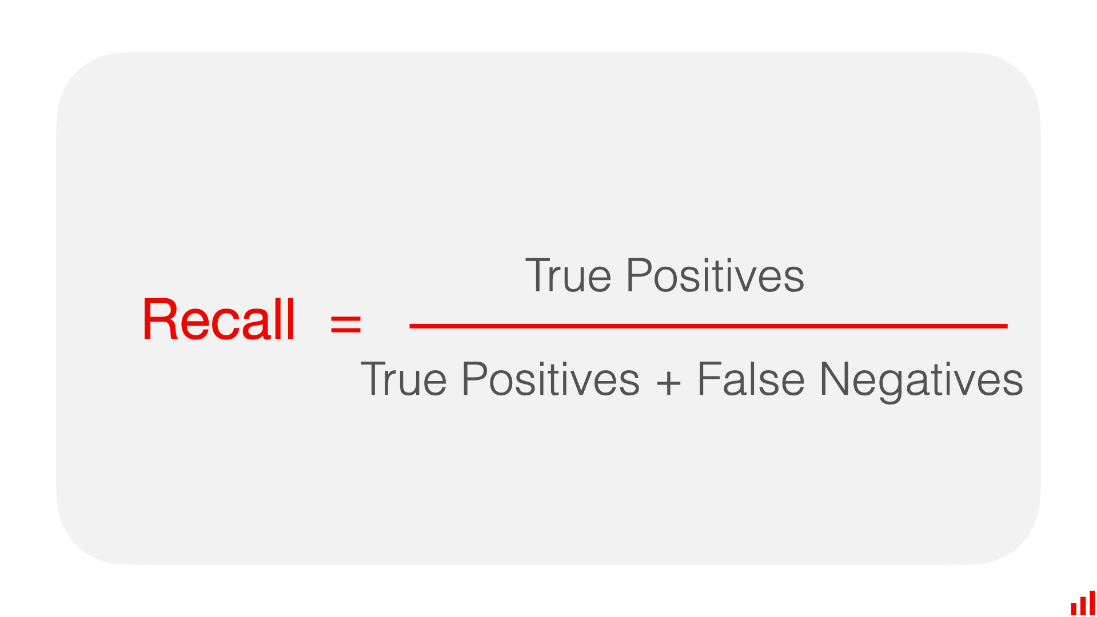
Key Metrics
+
Accuracy
Shows how often a classification ML model is correct overall
+
Recall
Shows whether an ML model can find all objects of the target class.
+

Slide 9
+
+
Model Evaluation
Accuracy:
86%
Recall:
15%
Logistics Regression
High accuracy but seems to predict more 0's than 1's
Decision Tree
Not as good as logistics regression
Accuracy:
83%
Recall:
14%
Random Forest
Better then the logistics at finding 0's but overall precision and recall are bad
Accuracy:
83%
Recall:
4%
+
Notes:
valuation Process:
Training vs. Testing data split.
Performance metrics: [insert confusion matrices]
Results:
Accuracy
Comparison with baseline or previous models.

Slide 10
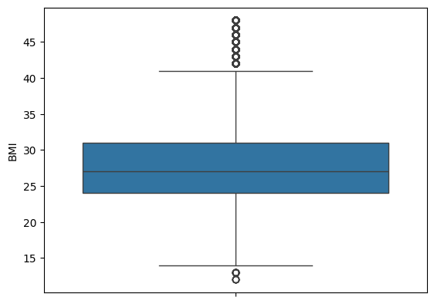
Model Optimization - What Worked?
Removing BMI Outliers
Accuracy:
86%
Recall:
15%

Slide 11
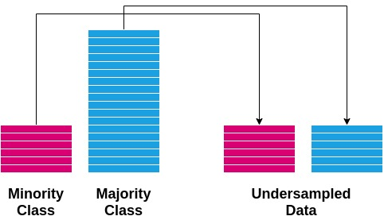
Model Optimization - What Worked?
Undersampling
Original: Undersampled:
0.0 218,334 0.0: 26,500
1.0 35,346 1.0: 26,500
Accuracy:
86%
Recall:
15%

Slide 12
Model Optimization - What Worked?
Removing BMI Outliers and Undersampling
Accuracy:
73%
Recall:
77%

Slide 13
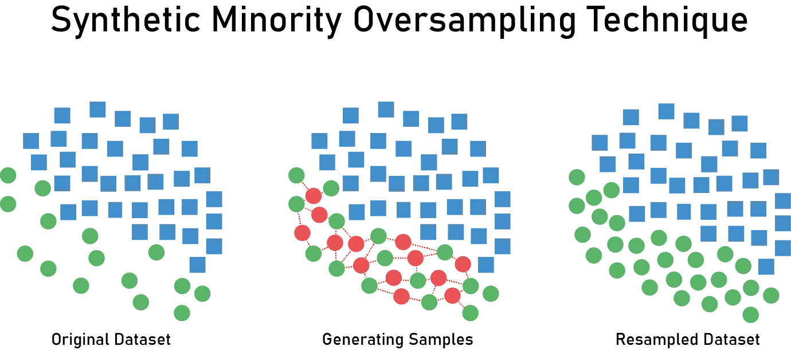
Model Optimization - What Didn’t Work?
SMOTE Oversampling
Accuracy:
83%
Recall:
45%
SMOTE Oversampling | Image source Medium

Slide 14
Model Optimization - What Didn’t Work?
Reducing Features
Top 5
BMI : 19%
Age: 14%
General Health: 11%
Physical Health: 8%
Education: 7%
Mental Health: 6%
High Cholesterol: 4%
Smoker: 3%
Fruits: 3%
Accuracy:
86%
Recall:
13%
Top 3
Accuracy:
86%
Recall:
11%

Slide 15
Model Optimization - What Also Worked?
Robust Scaling & Standard Scaler
Robust
precision recall f1-score support
1 0.32 0.76 0.45 8946
0 0.95 0.73 0.82 54474
accuracy 0.73 63420
macro avg 0.63 0.75 0.64 63420
weighted avg 0.86 0.73 0.77 63420
Standard Scaler
precision recall f1-score support
1 0.31 0.77 0.44 8928
0 0.95 0.72 0.82 54492
accuracy 0.73 63420
macro avg 0.63 0.75 0.63 63420
weighted avg 0.86 0.73 0.77 63420

Slide 16
+
+
+
+
Results and Conclusion
Chosen Model: Logistics Regression
Model Optimization: Undersampled outcomes and reduced BMI outliers
Accuracy: 73%
Recall: 77%
Conclusion: Our model is a good risk assessment tool but not a diagnostic tool

Slide 17

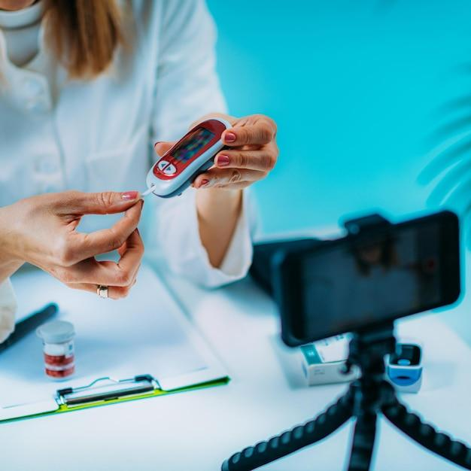
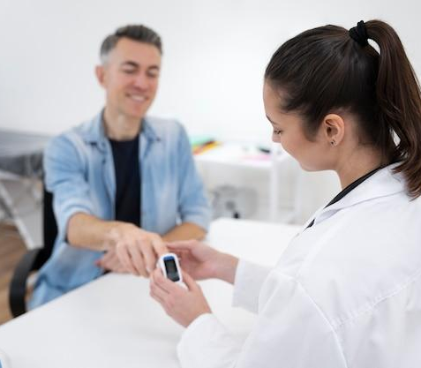
+
Next Steps
Future Research
Increase dataset for diabetes patients
Get current data
Expand the dataset globally
Potential for exploring more advanced models or additional features
Label the data more granularly (ex. Pre Diabetes vs Type 1 vs Type 2)
+
Next Steps
Develop an application for diabetes risk assessment to flag to users when they may need to go to the doctor and get an examination
+

Slide 18
Thank You!
What questions do you have?

Slide 19
Appendix

Slide 20
Citations
Ceriello, Antonio, and Francesco Prattichizzo. “Variability of Risk Factors and Diabetes Complications.” Cardiovascular Diabetology, U.S. National Library of Medicine, pubmed.ncbi.nlm.nih.gov/33962641/. Accessed 9 Sept. 2024.
“Lesson 4: Diabetes Risk Factors (English).” Edited by Care New England, YouTube, YouTube, 20 Oct. 2020, www.youtube.com/watch?v=rrX2Hn2iesM.
“Type 2 Diabetes.” Mayo Clinic, Mayo Foundation for Medical Education and Research, 14 Mar. 2023, www.mayoclinic.org/diseases-conditions/type-2-diabetes/symptoms-causes/syc-20351193.
“Diabetes Risk Factors.” Centers for Disease Control and Prevention, Centers for Disease Control and Prevention, www.cdc.gov/diabetes/risk-factors/index.html. Accessed 9 Sept. 2024.
ND, Wong ND, and Sattar N. “Cardiovascular Risk in Diabetes Mellitus: Epidemiology, Assessment and Prevention.” Nature Reviews. Cardiology, U.S. National Library of Medicine, pubmed.ncbi.nlm.nih.gov/37193856/. Accessed 9 Sept. 2024.
“Accuracy vs. Precision vs. Recall in Machine Learning: What’s the Difference?” Evidently AI - Open-Source ML Monitoring and Observability, www.evidentlyai.com/classification-metrics/accuracy-precision-recall. Accessed 9 Sept. 2024.

Slide 21
Variable Name | Role | Type | Demographic | Description | Units | Missing Values
ID | ID | Integer |  | Patient ID |  | no
Diabetes_binary | Target | Binary |  | 0 = no diabetes 1 = prediabetes or diabetes |  | no
HighBP | Feature | Binary |  | 0 = no high BP 1 = high BP |  | no
HighChol | Feature | Binary |  | 0 = no high cholesterol 1 = high cholesterol |  | no
CholCheck | Feature | Binary |  | 0 = no cholesterol check in 5 years 1 = yes cholesterol check in 5 years |  | no
BMI | Feature | Integer |  | Body Mass Index |  | no
Smoker | Feature | Binary |  | Have you smoked at least 100 cigarettes in your entire life? [Note: 5 packs = 100 cigarettes] 0 = no 1 = yes |  | no

Slide 22
Variable Name | Role | Type | Demographic | Description | Units | Missing Values
Stroke | Feature | Binary |  | (Ever told) you had a stroke. 0 = no 1 = yes |  | no
HeartDiseaseorAttack | Feature | Binary |  | coronary heart disease (CHD) or myocardial infarction (MI) 0 = no 1 = yes |  | no
PhysActivity | Feature | Binary |  | physical activity in past 30 days - not including job 0 = no 1 = yes |  | no
Fruits | Feature | Binary |  | Consume Fruit 1 or more times per day 0 = no 1 = yes |  | no
Veggies | Feature | Binary |  | Consume Vegetables 1 or more times per day 0 = no 1 = yes |  | no
HvyAlcoholConsump | Feature | Binary |  | Heavy drinkers (adult men having more than 14 drinks per week and adult women having more than 7 drinks per week) 0 = no 1 = yes |  | no

Slide 23
Variable Name | Role | Type | Demographic | Description | Units | Missing Values
AnyHealthcare | Feature | Binary |  | Have any kind of health care coverage, including health insurance, prepaid plans such as HMO, etc. 0 = no 1 = yes |  | no
NoDocbcCost | Feature | Binary |  | Was there a time in the past 12 months when you needed to see a doctor but could not because of cost? 0 = no 1 = yes |  | no
GenHlth | Feature | Integer |  | Would you say that in general your health is: scale 1-5 1 = excellent 2 = very good 3 = good 4 = fair 5 = poor |  | no
MentHlth | Feature | Integer |  | Now thinking about your mental health, which includes stress, depression, and problems with emotions, for how many days during the past 30 days was your mental health not good? scale 1-30 days |  | no

Slide 24
Variable Name | Role | Type | Demographic | Description | Units | Missing Values
PhysHlth | Feature | Integer |  | Now thinking about your physical health, which includes physical illness and injury, for how many days during the past 30 days was your physical health not good? scale 1-30 days |  | no
DiffWalk | Feature | Binary |  | Do you have serious difficulty walking or climbing stairs? 0 = no 1 = yes |  | no
Sex | Feature | Binary | Sex | 0 = female 1 = male |  | no
Age | Feature | Integer | Age | 13-level age category (_AGEG5YR see codebook) 1 = 18-24 9 = 60-64 13 = 80 or older |  | no

Slide 25
Variable Name | Role | Type | Demographic | Description | Units | Missing Values
Education | Feature | Integer | Education Level | Education level (EDUCA see codebook) scale 1-6 1 = Never attended school or only kindergarten 2 = Grades 1 through 8 (Elementary) 3 = Grades 9 through 11 (Some high school) 4 = Grade 12 or GED (High school graduate) 5 = College 1 year to 3 years (Some college or technical school) 6 = College 4 years or more (College graduate) |  | no
Income | Feature | Integer | Income | Income scale (INCOME2 see codebook) scale 1-8 1 = less than $10,000 5 = less than $35,000 8 = $75,000 or more |  | no

Slide 26
Model Evaluation
+
precision recall f1-score support
1 0.53 0.15 0.24 8956
0 0.88 0.98 0.92 54464
accuracy 0.86 63420
macro avg 0.70 0.57 0.58 63420
weighted avg 0.83 0.86 0.83 63420
Logistics Regression
High accuracy but seems to predict more 0's than 1's
+
precision recall f1-score support
1 0.14 0.04 0.06 8922
0 0.86 0.96 0.91 54498
accuracy 0.83 63420
macro avg 0.50 0.50 0.48 63420
weighted avg 0.76 0.83 0.79 63420
Decision Tree
Not as good as logistics regression
precision recall f1-score support
1 0.14 0.04 0.06 8922
0 0.86 0.96 0.91 54498
accuracy 0.83 63420
macro avg 0.50 0.50 0.48 63420
weighted avg 0.76 0.83 0.79 63420
Random Forest
Better then the logistics at finding 0's but overall precision and recall are bad
+
Notes:
valuation Process:
Training vs. Testing data split.
Performance metrics: [insert confusion matrices]
Results:
Accuracy
Comparison with baseline or previous models.

Slide 27
Model Optimization - What Worked?
Removing BMI Outliers
precision recall f1-score support
1 0.53 0.15 0.24 8956
0 0.88 0.98 0.92 54464
accuracy 0.86 63420
macro avg 0.70 0.57 0.58 63420
weighted avg 0.83 0.86 0.83 63420

Slide 28
Model Optimization - What Worked?
Undersampling
Original: Undersampled:
0.0 218334 0.0: 26500
1.0 35346 1.0: 26500
precision recall f1-score support
1 0.52 0.15 0.24 8846
0 0.88 0.98 0.92 54574
accuracy 0.86 63420
macro avg 0.70 0.57 0.58 63420
weighted avg 0.83 0.86 0.83 63420

Slide 29
Model Optimization - What Worked?
Removing BMI Outliers and Undersampling
precision recall f1-score support
1 0.31 0.77 0.44 8551
0 0.95 0.72 0.82 54129
accuracy 0.73 62680
macro avg 0.63 0.75 0.63 62680
weighted avg 0.86 0.73 0.77 62680

Slide 30
Model Optimization - What Didn’t Work?
SMOTE Oversampling
precision recall f1-score support
1 0.39 0.45 0.42 8861
0 0.91 0.89 0.90 54559
accuracy 0.83 63420
macro avg 0.65 0.67 0.66 63420
weighted avg 0.84 0.83 0.83 63420
SMOTE Oversampling | Image source Medium

Slide 31
Model Optimization - What Didn’t Work?
Reducing Features
5 features
precision recall f1-score support
1 0.53 0.13 0.20 8767
0 0.87 0.98 0.93 54653
accuracy 0.86 63420
macro avg 0.70 0.55 0.56 63420
weighted avg 0.83 0.86 0.83 63420
BMI : 19%
Age: 14%
General Health: 11%
Physical Health: 8%
Education: 7%
Mental Health: 6%
High Cholesterol: 4%
Smoker: 3%
Fruits: 3%
3 features
precision recall f1-score support
1 0.50 0.11 0.19 8899
0 0.87 0.98 0.92 54521
accuracy 0.86 63420
macro avg 0.69 0.55 0.55 63420
weighted avg 0.82 0.86 0.82 63420

Slide 32





Thank You!
We respect your valuable time with SlideEgg!
If you have any questions, please reach us
Do you have a design request, please visit our redesign page.
CREDIT: SlideEgg created this PowerPoint template.
Let this slide be kept for attribution.
www.slideegg.com

